Slide 1
BINAR ACADEMY DATA SCIENCE WAVE 5 GROUP 3 WE ARE: BAGAS NAUFAL ALFATHAN DAVINCA RIZQY ADINDA ISMAIL VIVI FITRIANI
CHALLENGE PLATINUM LEVEL

Slide 2
INTRODUCTION

Slide 3
Research Background
The rapid increase in online communication has resulted in vast amounts of unstructured data, such as social media posts, reviews, and customer feedback. The availability of this data presents a unique opportunity to gain insights into customer opinions and attitudes towards products and services.
Sentiment analysis is a natural language processing technique that can be used to extract subjective information from text data, providing valuable insights into customer sentiment and opinion.
However, analyzing large volumes of text data manually can be time-consuming and prone to errors. To overcome these challenges, deep learning models such as CNN, LSTM, and Feed-Forward Neural Network have been widely used for sentiment analysis tasks. The use of these models has shown promising results in achieving high accuracy in sentiment classification. Therefore, this study aims to explore the effectiveness of these deep learning models in sentiment analysis tasks and to identify the optimal model for analyzing text data.

Slide 4
Project analysis slide 3
Project Goals
EXPLORATORY DATA ANALYSIS
PREPROCESSING DATA FOR MODELING
BUILD MODEL
MODEL EVALUATION
BUILD API AND THE DOCUMENTATION
Knowing how well the model can be used to accurately predict values on new data (Validation and Test) using evaluation metrics, namely accuracy, precision, recall, F1-score, and area under the ROC curve?
Wordcloud
Word frequency
Data distribution
Analyze data from total word and total character
How can text data be utilized for training a model?
How to build model with the best accuracy to predict sentiment from text data using Deep Learning Architecture (CNN and RNN)?
Building an API that can perform data preprocessing and sentiment analysis using Flask, and documenting it with Swagger UI.

Slide 5
Project analysis slide 2
Research Flow
CLEANSING DATA
BUILD API AND THE DOCUMENTATION
SENTIMENT
ANALYSIS
EXPLORATORY DATA
ANALYSIS (EDA)
MODEL EVALUATION
IF NOT GOOD
PREPROCESSING DATA FOR MODELING
BUILD MODEL USING
CNN AND RNN

Slide 6
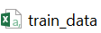
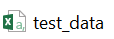






Project analysis slide 4
What Data and Tools
We Use?
tweets | labels
Text data | Contain sentiment labels
Text data | Contain sentiment labels
Text data | Contain sentiment labels
……………… | ……………….
tweets | labels
Text data | Contain sentiment labels
Text data | Contain sentiment labels
Text data | Contain sentiment labels
……………… | ……………….
Contain 9900 data text
There is duplicate data
Nothing null
Contain 1100 data text
API Framework
API Documentation

Slide 7
EXPLORATORY DATA ANALYSIS

Slide 8
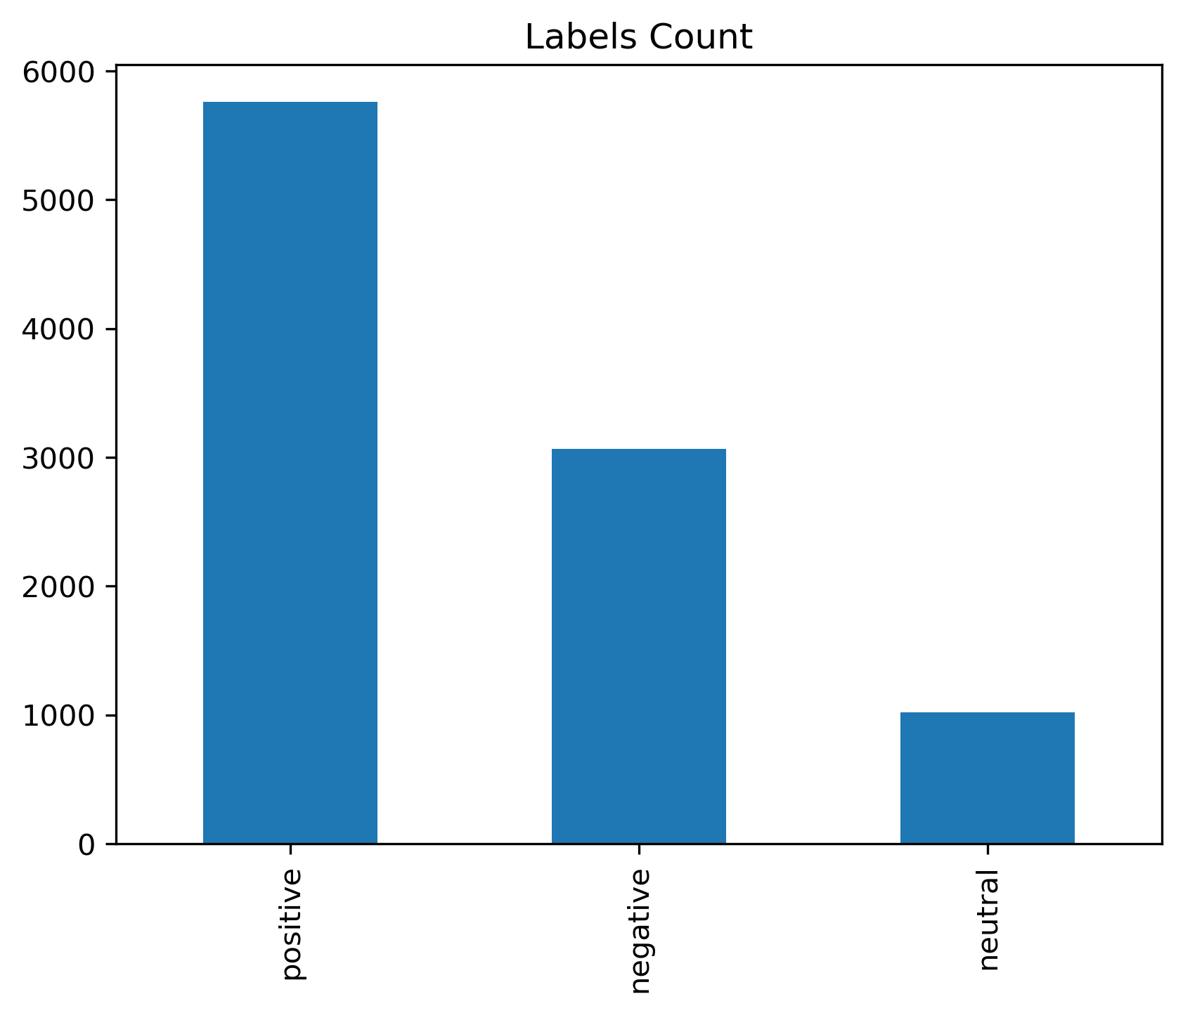
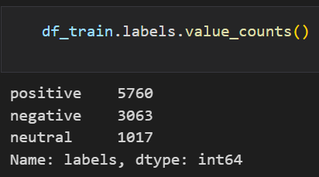
Project analysis slide 5
EDA
DATA WITH POSITIVE SENTIMENT
5,760
DATA WITH NEGATIVE SENTIMENT
3,063
DATA WITH NEUTRAL SENTIMENT
1,017
From the chart above, we can see that the train data has an imbalanced class/labels, as the number of labels is uneven, and the difference is too far, especially between data with positive and neutral labels.

Slide 9
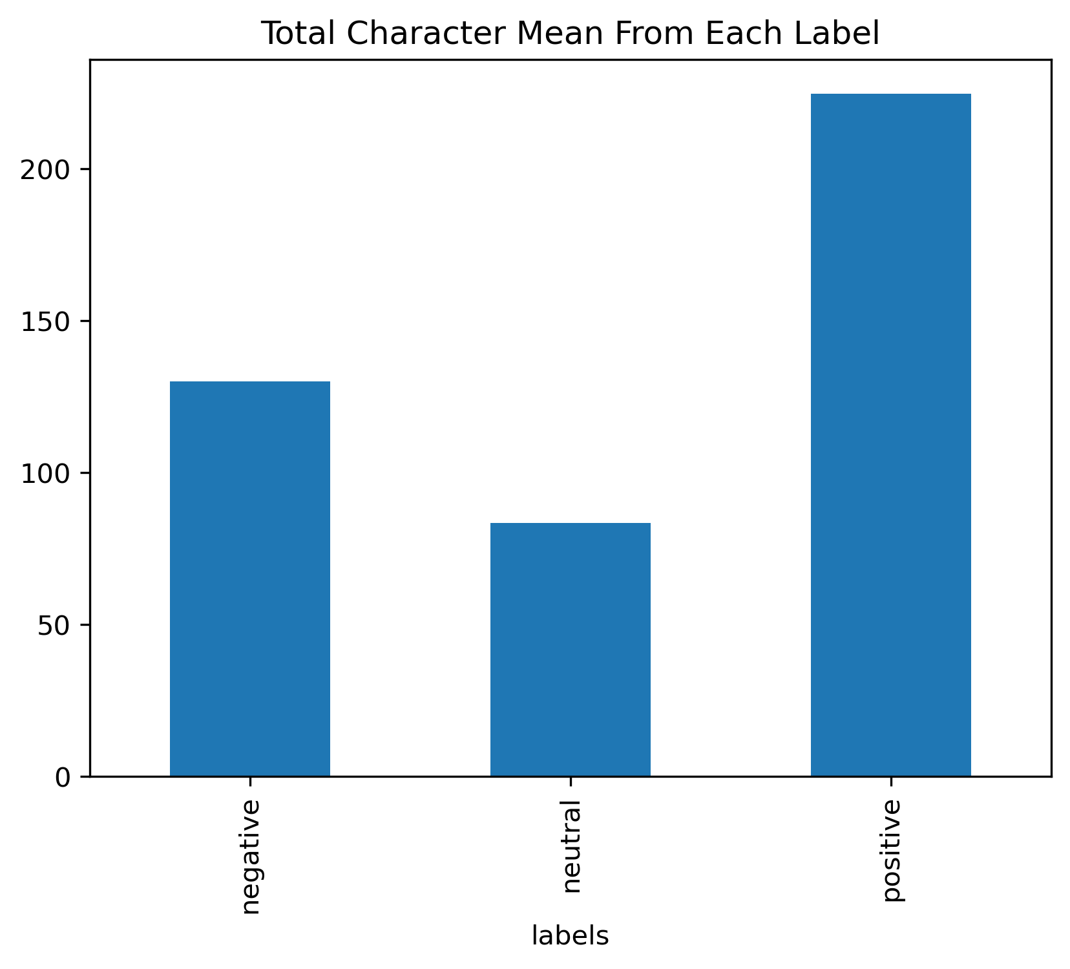

Project analysis slide 5
EDA
In both charts above, we can see that data with the positive label has the highest average word length and character count, followed by data with the negative label, and lastly by data with the neutral label. This also represents that there are more data with a positive label

Slide 10
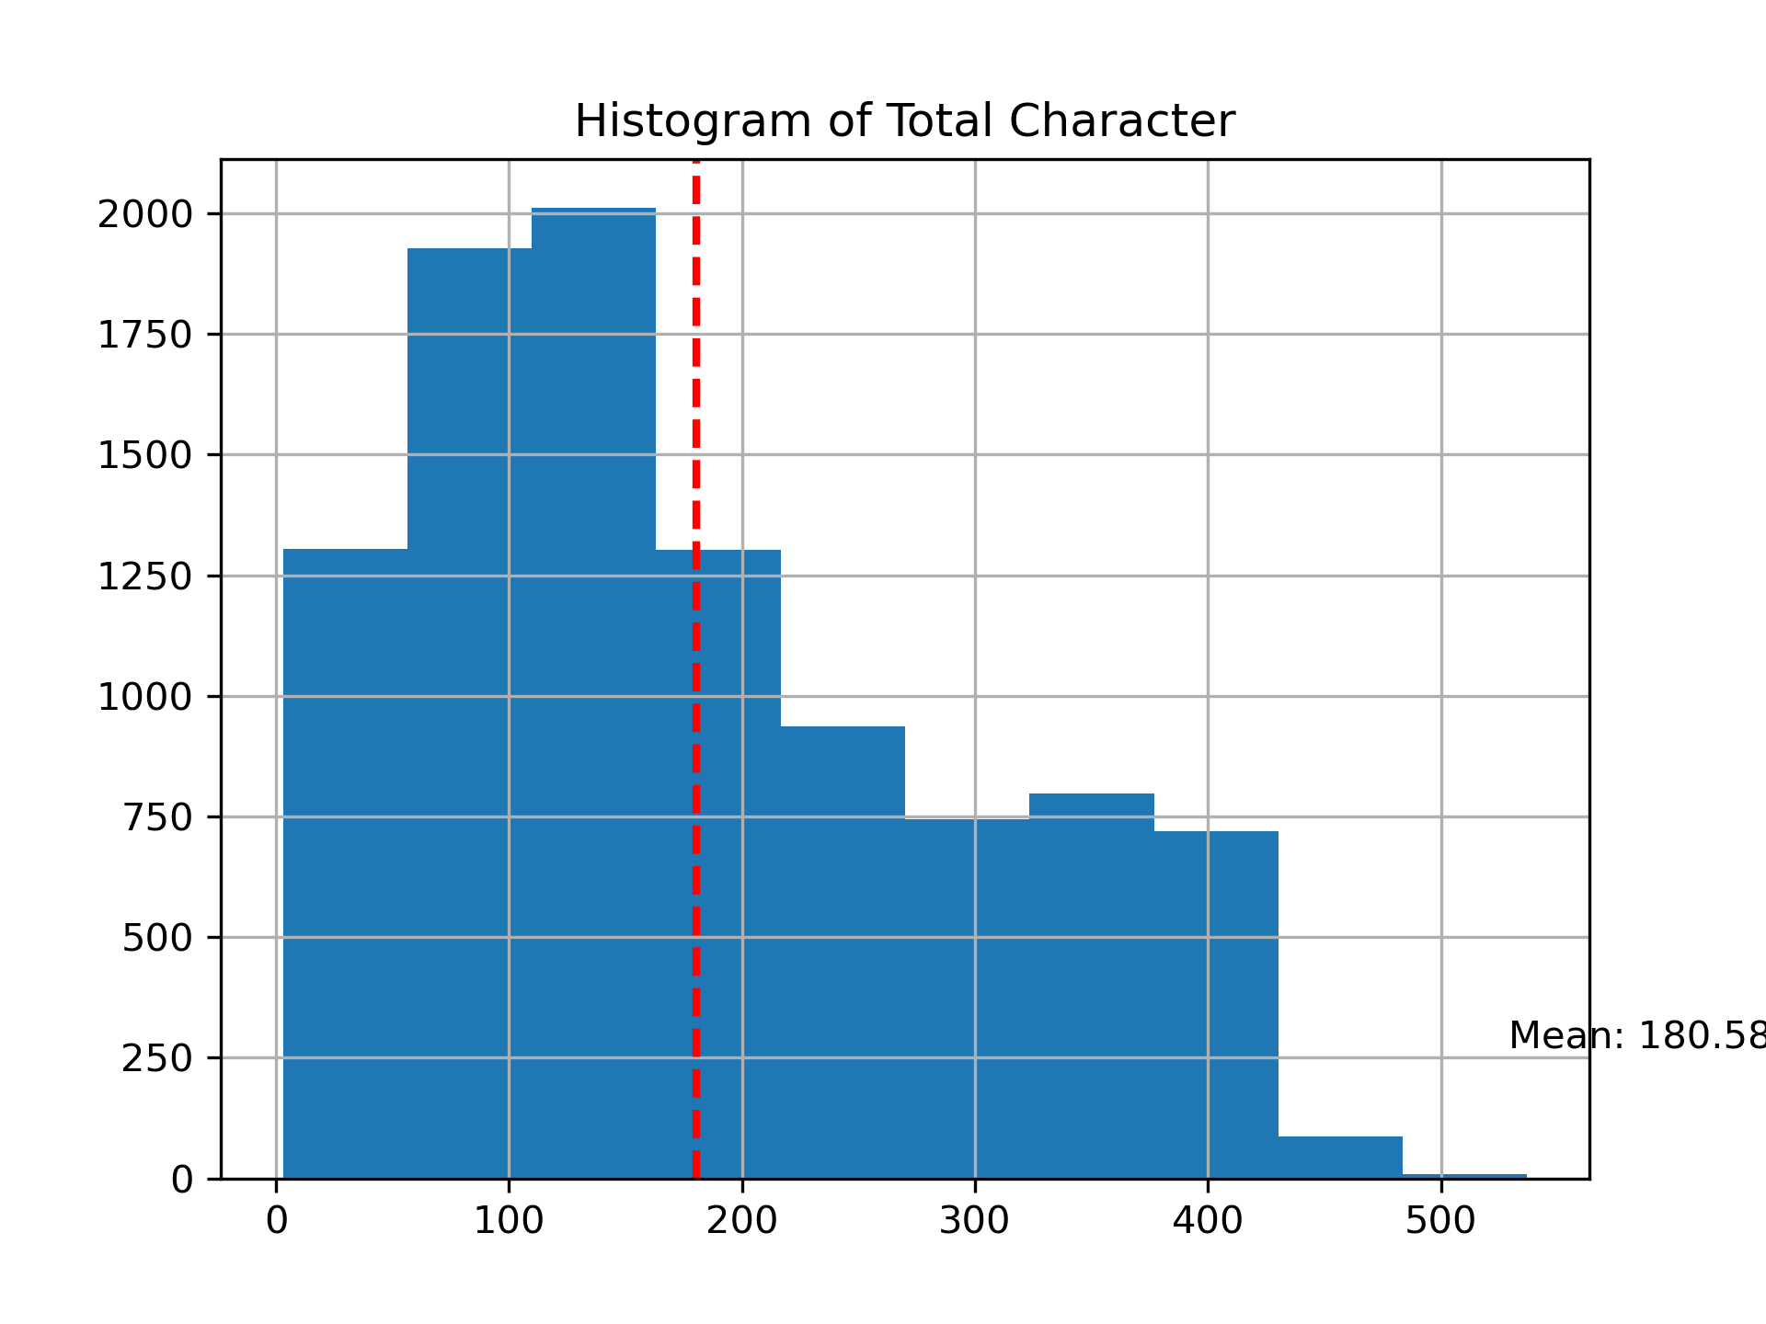
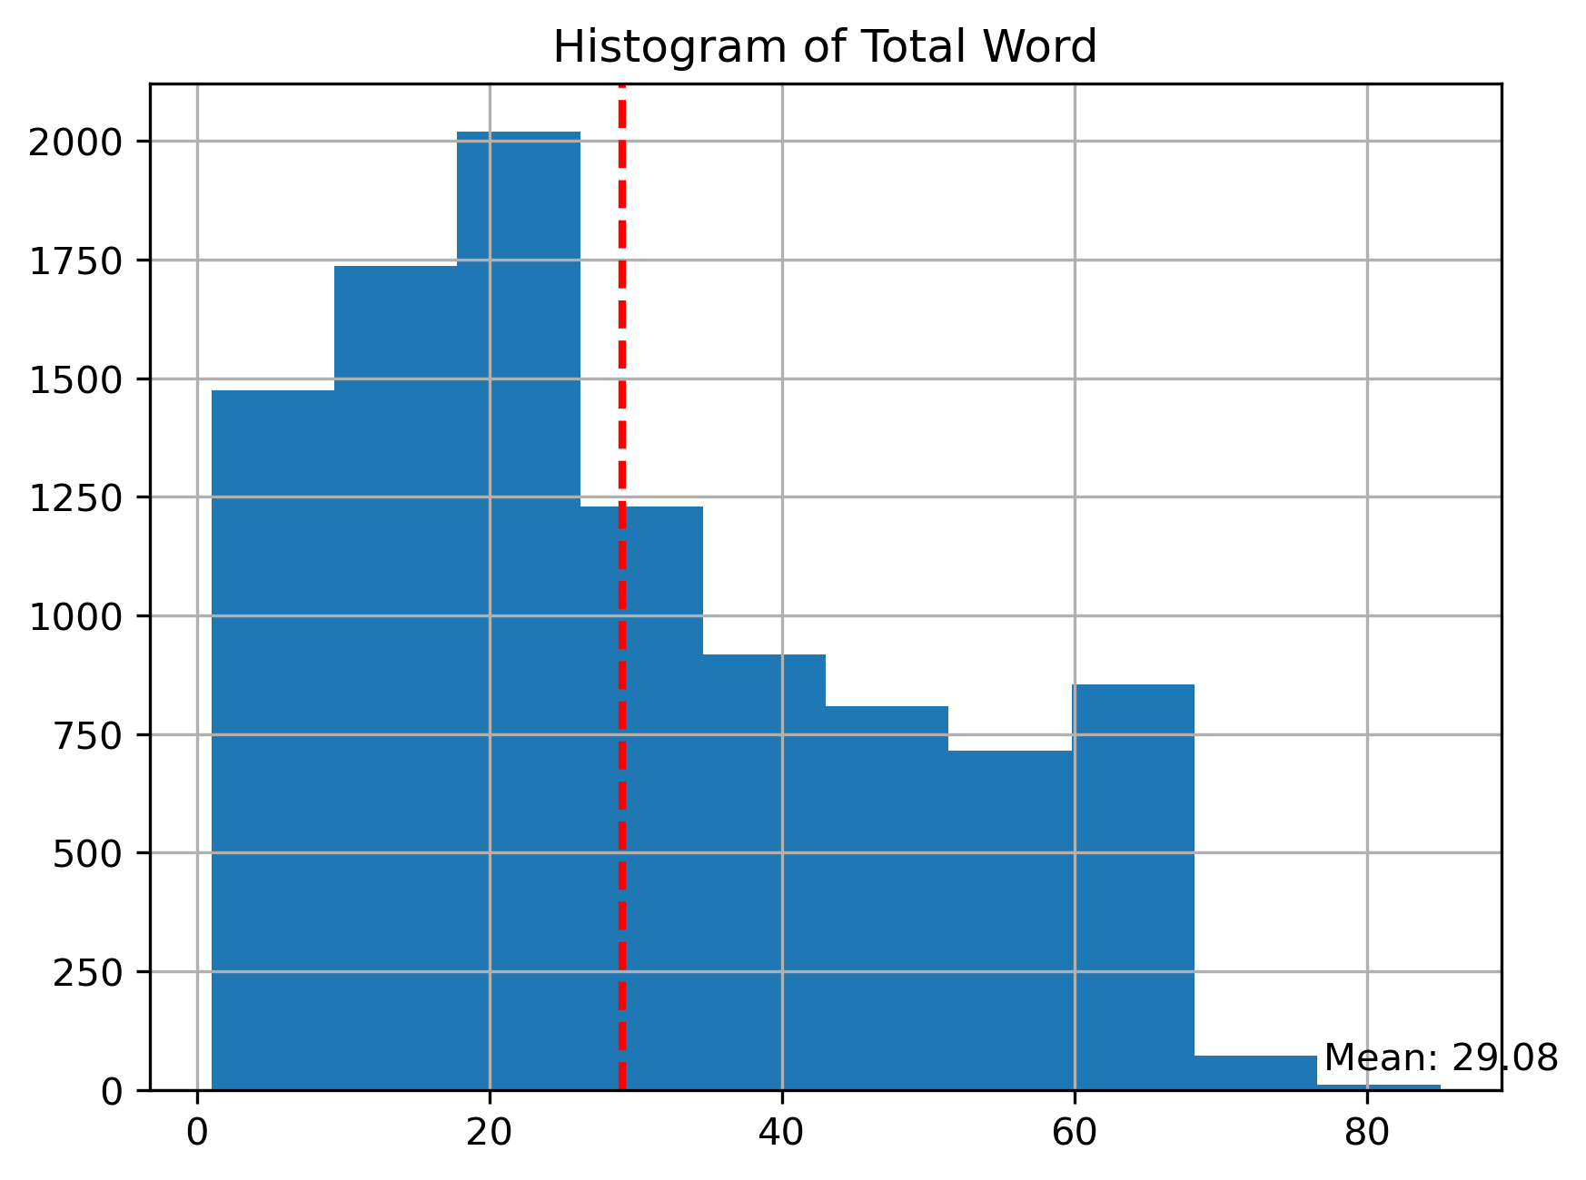
Project analysis slide 5
EDA
From the histogram chart of total characters, we can see that the mean of the total characters is 180.58 == 181 characters. We can also see that around more than 2000 data have an average of 100-150 characters.
Meanwhile, from the histogram chart of total words, we can see that the mean of the total words is 29.08 == 29 words. We can also see that around more than 2000 words have a total of 20 words.

Slide 11
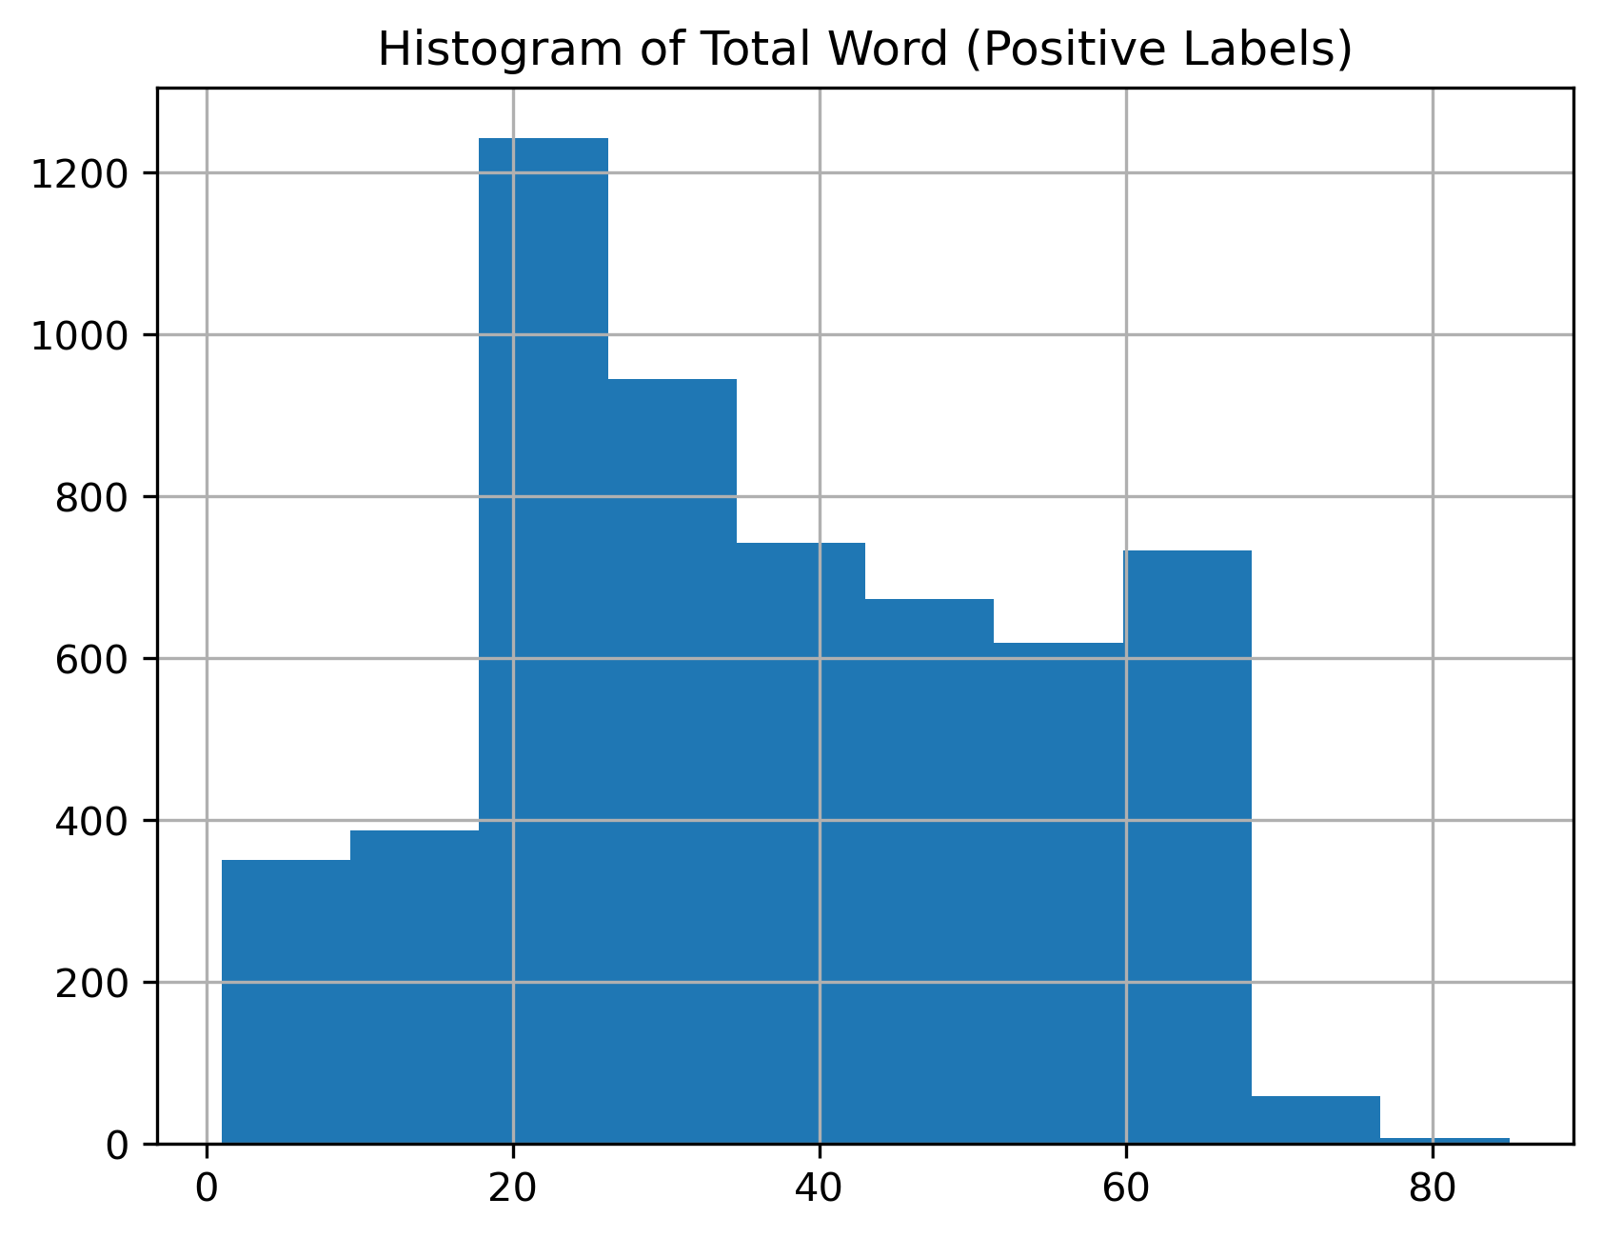
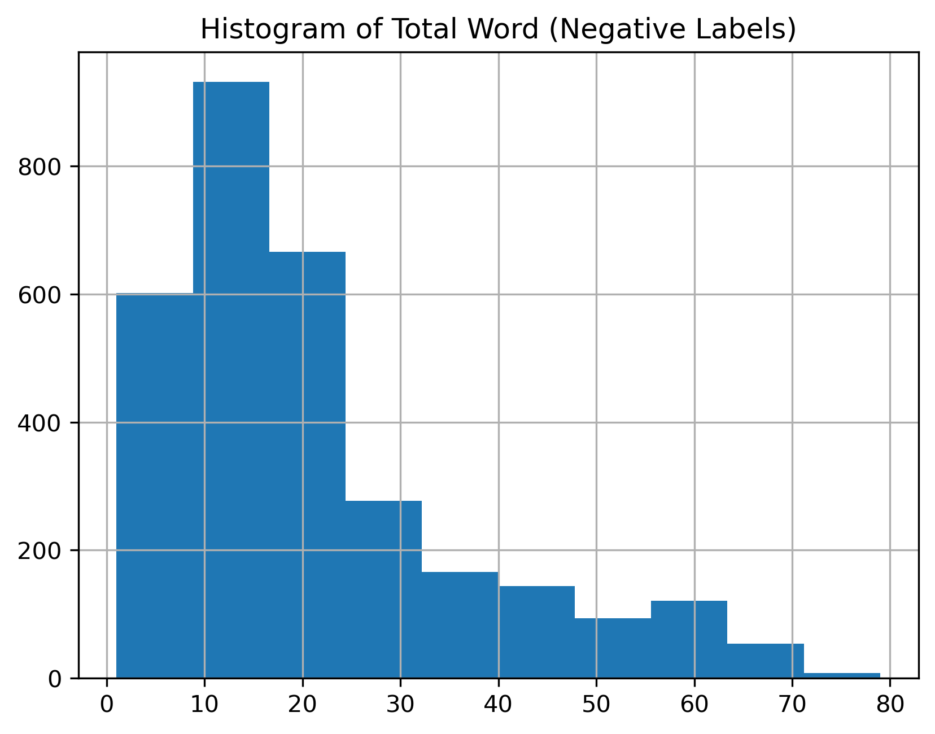
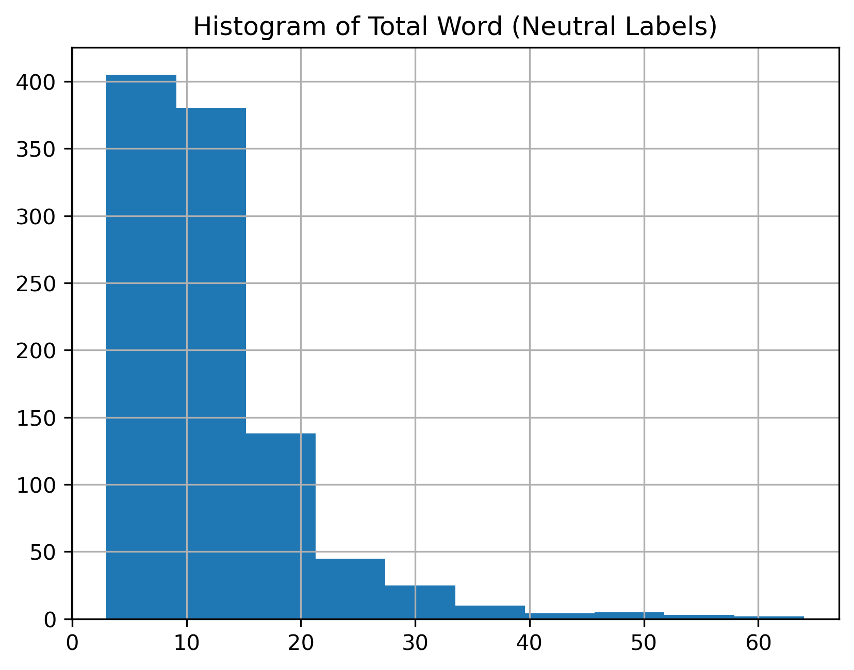
Project analysis slide 5
EDA
Based on the chart above, we can see that in the positive label/class, it is dominated by data with a total of 20 words, amounting to 1200 data.
In the negative label/class, it is dominated by data with a total of 10-15 words, amounting to 800-900 data.
In the neutral label/class, it is dominated by data with a total of 1-10 words, amounting to 400 data.

Slide 12
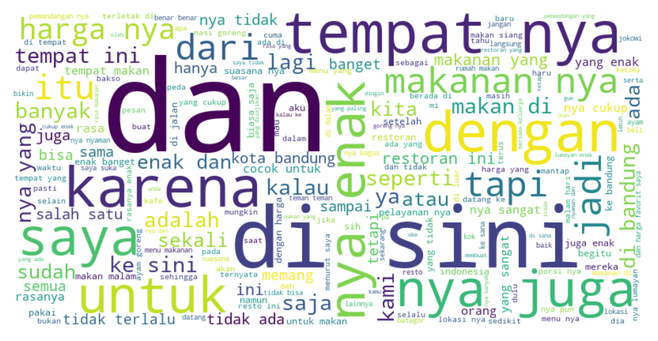
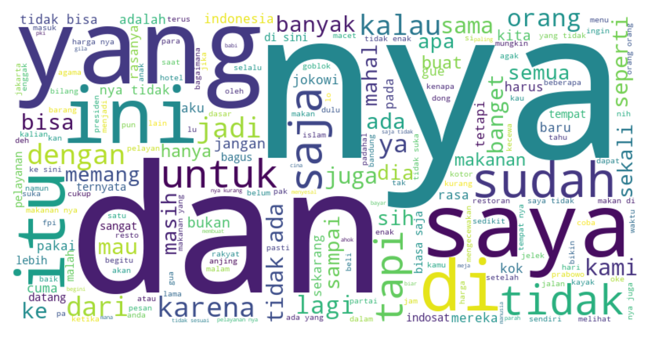
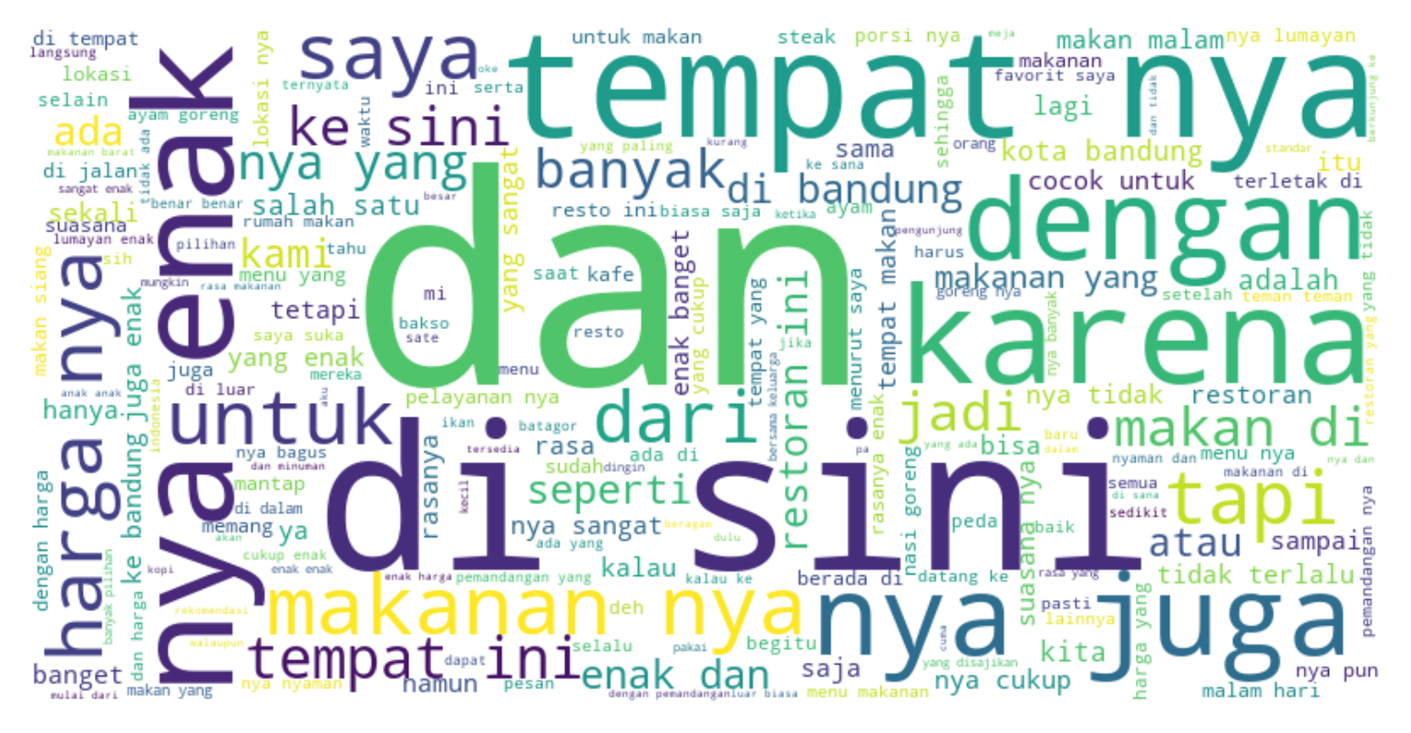
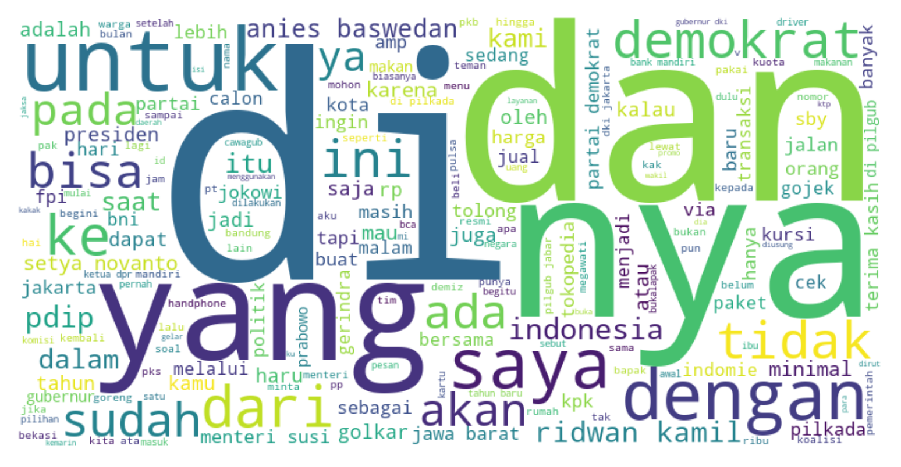
Project analysis slide 5
EDA
BAG
OF
WORDS
Top 10 Words of All The Data :
[('nya', 12128),
('yang', 8332),
('dan', 7130),
('di', 6950),
('tidak', 3908),
('saya', 3891),
('dengan', 3593),
('enak', 3373),
('makanan', 3213),
('ini', 3192)]
Top 10 Words of The Data With Positive Labels :
[('nya', 9866), ('yang', 6615), ('dan', 5807),
('di', 5582), ('enak', 3142), ('dengan', 2897), ('tempat', 2874), ('makanan', 2857), ('saya', 2805), ('untuk', 2454)]
Top 10 Words of The Data With Negative Labels :
[('nya', 2078), ('tidak', 1732), ('yang', 1531), ('dan', 1129),
('di', 1063),
('saya', 967),
('ini', 694),
('saja', 593), ('dengan', 575), ('itu', 550)]
Top 10 Words of The Data With Neutral Labels :
[('di', 305),
('dan', 194), ('yang', 186), ('nya', 184), ('untuk', 135), ('dengan', 121), ('saya', 119), ('demokrat', 90), ('ke', 81),
('tidak', 79)]
Wordcloud of All The Data
Wordcloud of Data With
Negative Labels
Wordcloud of Data With
Positive Labels
Wordcloud of Data With
Neutral Labels

Slide 13
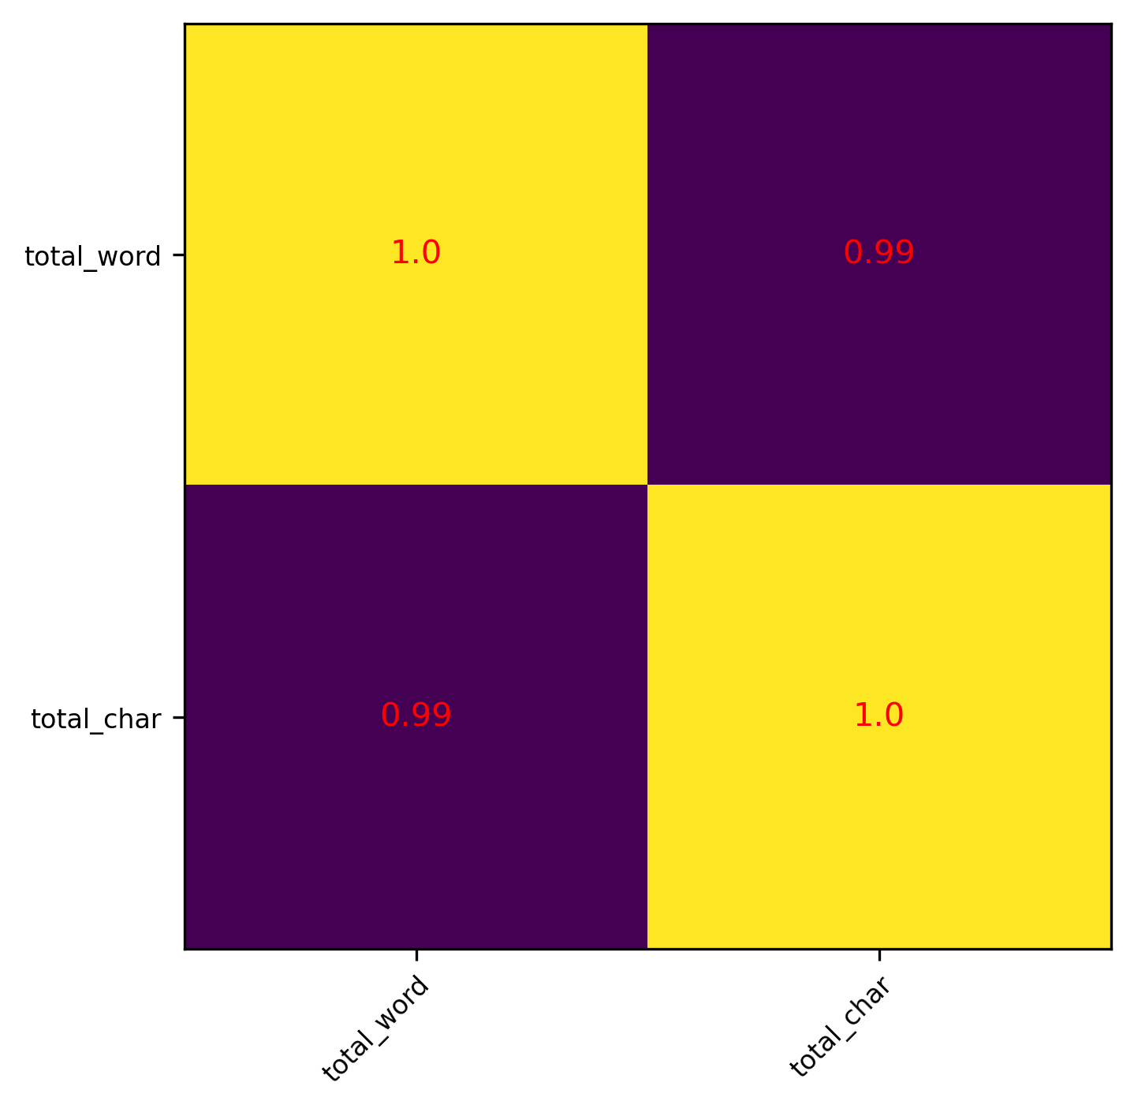
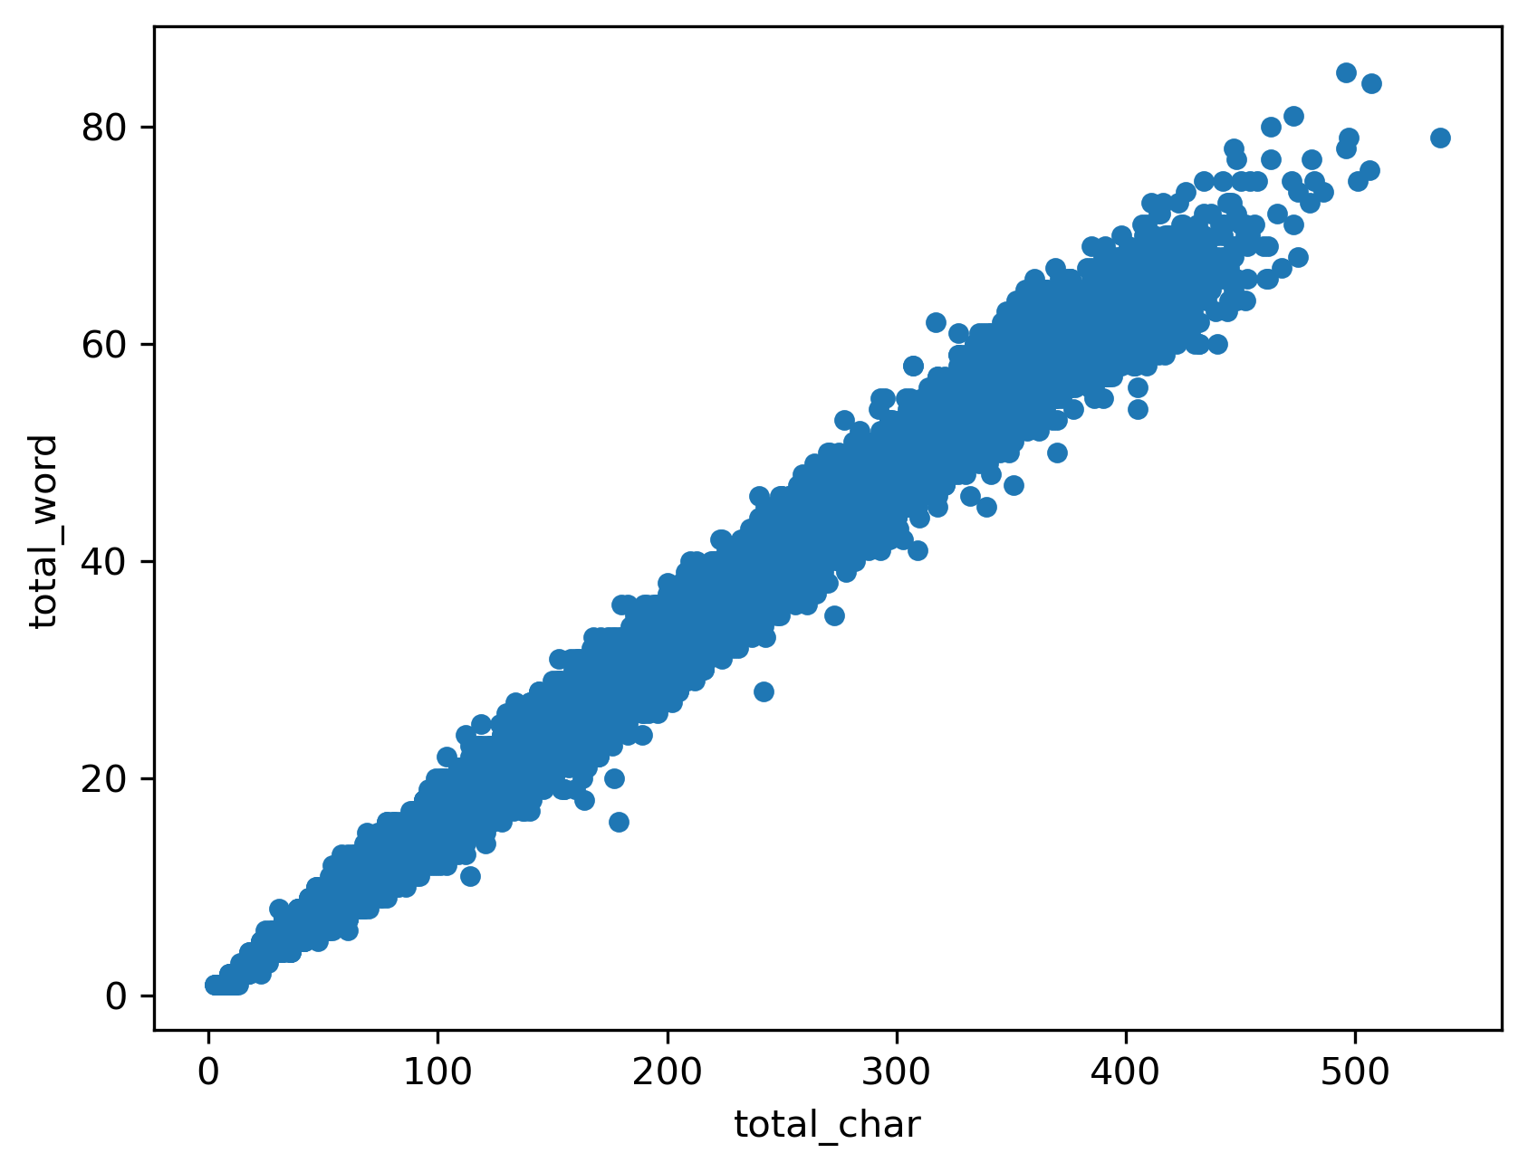
BIVARIATE ANALYSIS
EDA

Slide 14
WHAT WE DO? * CLEANSING DATA * CHECK DUPLICATES DATA * CHECK OUTLIER OF WORDS IN THE DATA * SPLITTING DATA TRAIN * TOKENIZING DATA (CONVERT TEXT DATA TO NUMERICAL) * BALANCING DATA BASED ON LABELS/CLASS
PREPROCESSING DATA BEFORE MODELING

Slide 15
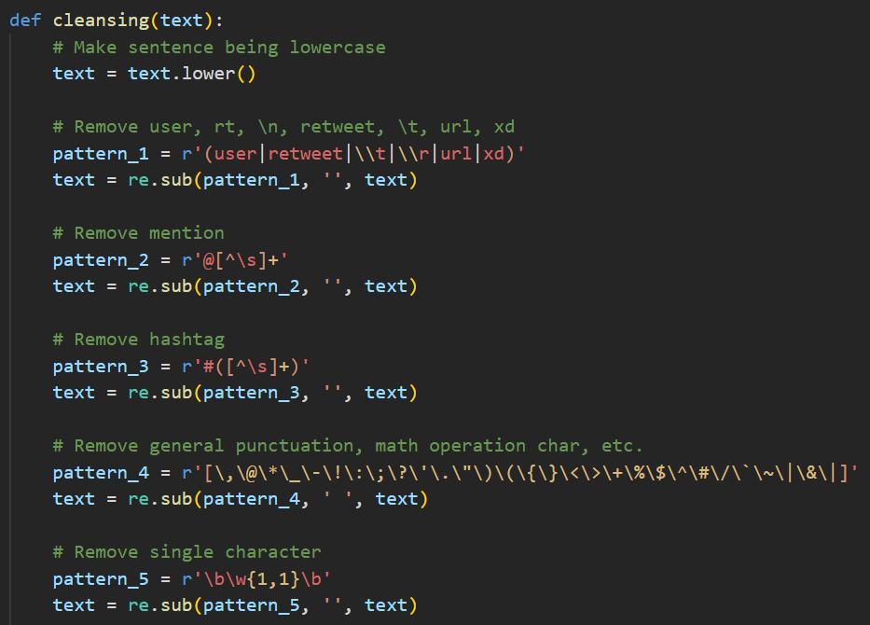
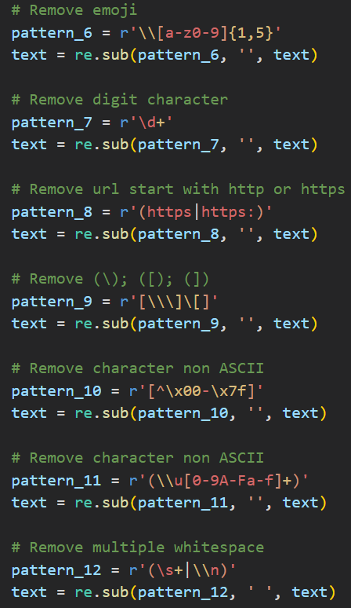
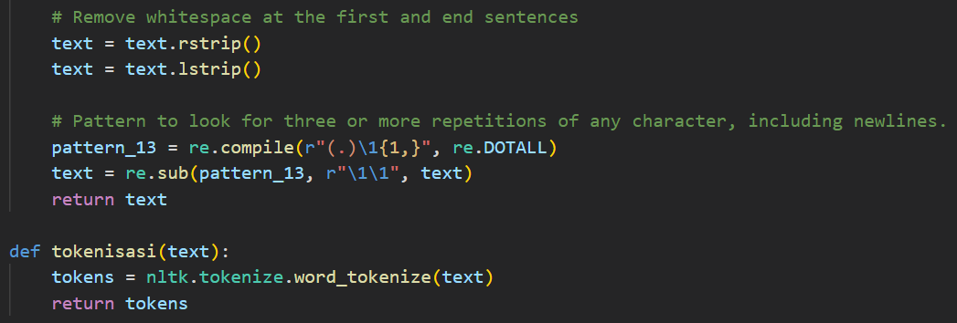
CLEANSING DATA
PREPROCESSING
DATA

Slide 16
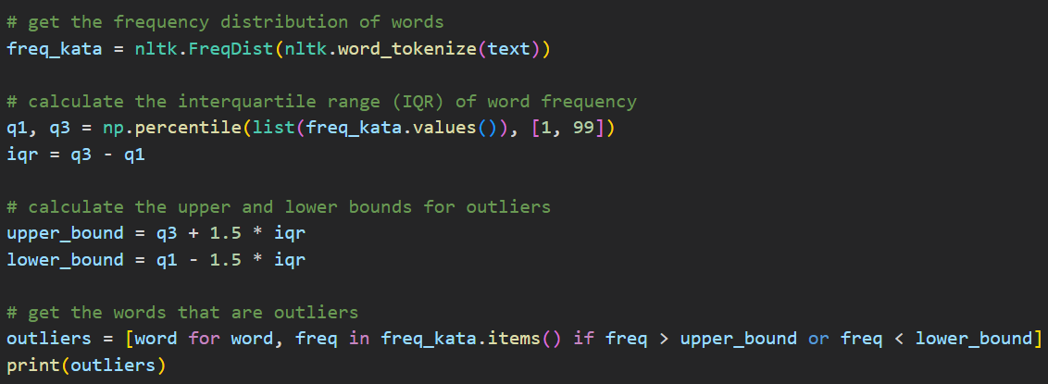
LIST OF OUTLIER WORDS
PREPROCESSING
DATA
We drop the list of outlier words from the data, because we think the upper limit outlier will very affect the labels,
And the lower limit outlier will not too affect the labels
['tempat', 'yang', 'nyaman', 'untuk', 'dengan', 'ada', 'kalau', 'malam', 'cukup', 'enak', 'di', 'jalan', 'harga', 'banyak', 'ke', 'rasanya', 'itu', 'seperti', 'buat', 'bandung', 'tidak', 'nya', 'dan', 'makan', 'restoran', 'ini', 'menu', 'sangat', 'makanan', 'rasa', 'saya', 'tapi', 'banget', 'nasi', 'ayam', 'goreng', 'juga', 'adalah', 'bisa', 'pelayanan', 'saja', 'dari', 'suasana', 'pemandangan', 'lebih', 'bagus', 'sini', 'sudah', 'kami', 'karena', 'kita', 'suka', 'orang', 'sekali', 'jadi', 'sama']

Slide 17
SPLITTING TRAIN DATA
PREPROCESSING
DATA
Data Train
Train Data :
8,856 Data
Validation Data :
984 Data

Slide 18
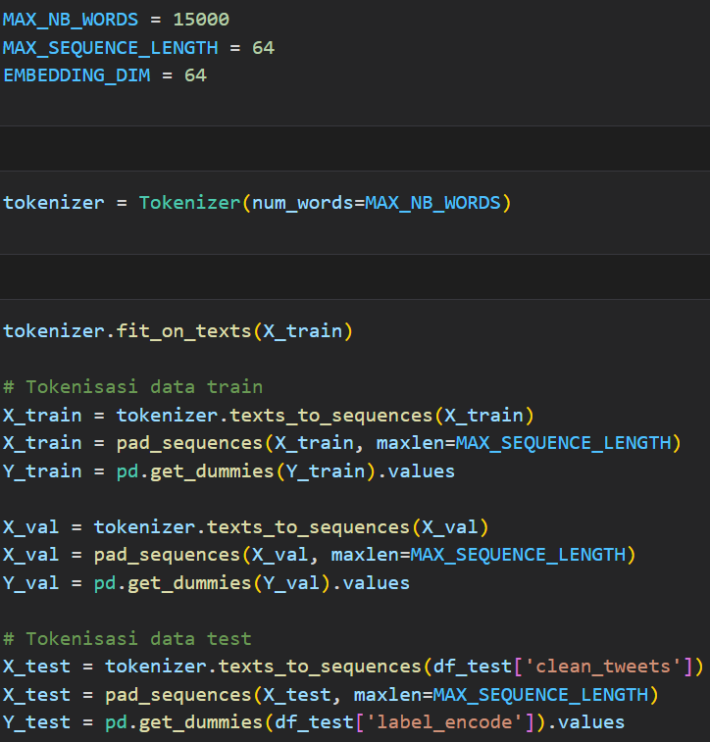
TOKENIZING ALL DATA
PREPROCESSING
DATA

Slide 19
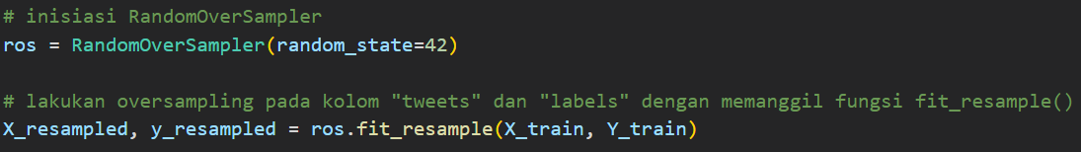
BALANCING TRAIN DATA
PREPROCESSING
DATA
We performed data balancing on the train data because it had imbalanced labels using the method of oversampling from imblearn. The number of data and labels became the same as the data with the most frequent label, which is the positive label.

Slide 20
WHAT DEEP LEARNING ARCHITECTURE WE USE? * Long Short Term Memory * Convolutional Neural Network (CNN) * Feed Forward Neural Network
MODELING
(DEEP LEARNING)

Slide 21
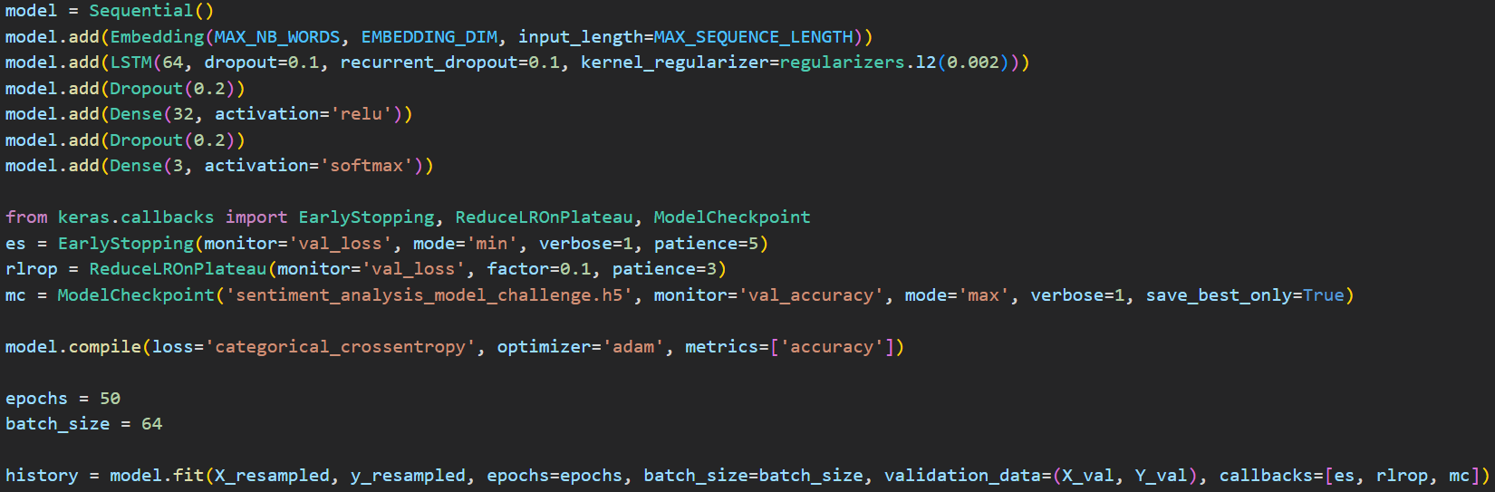
LONG SHORT TERM MEMORY (LSTM)
MODELING
BUILD LSTM MODEL AND TRAIN THE MODEL

Slide 22
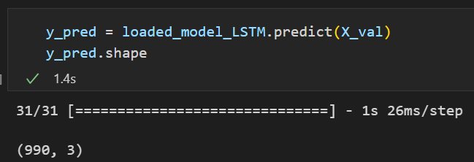
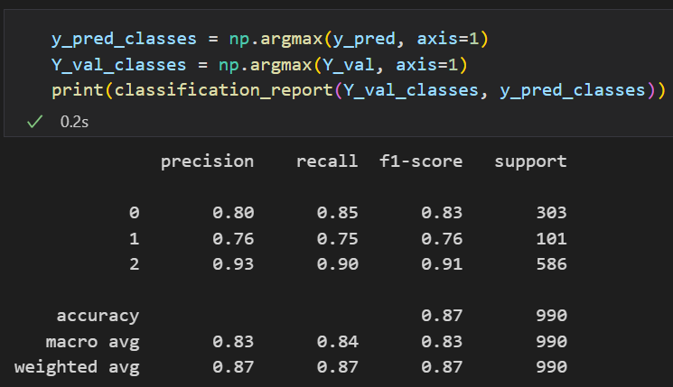
LONG SHORT TERM MEMORY (LSTM)
MODELING
Model evaluation using validation data

Slide 23
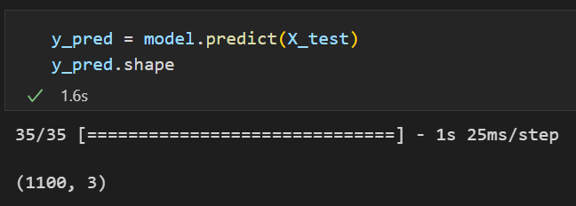
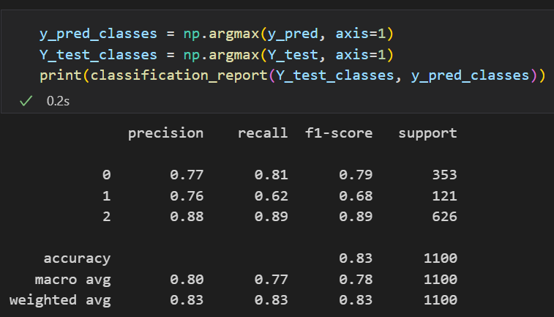
LONG SHORT TERM MEMORY (LSTM)
MODELING
Model evaluation using test data

Slide 24
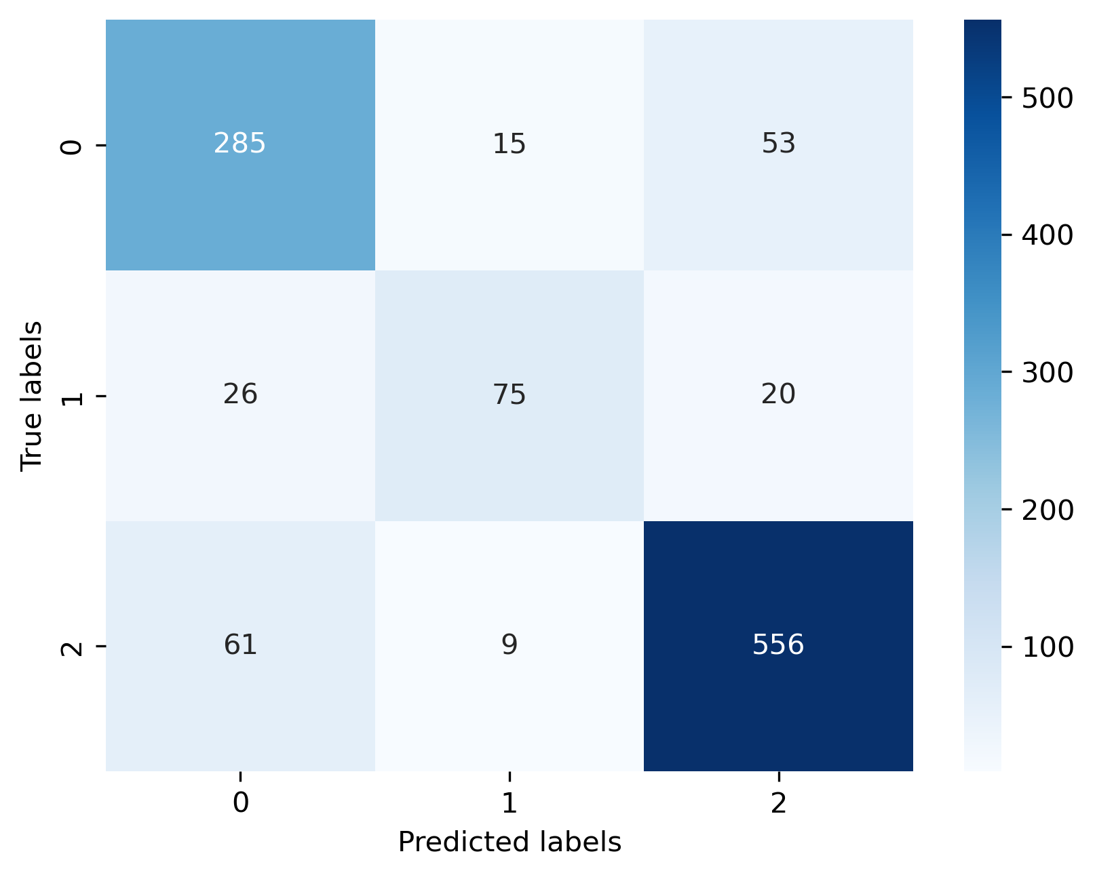
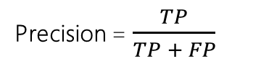
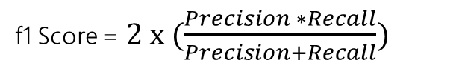
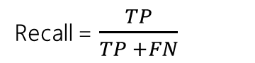
LONG SHORT TERM MEMORY (LSTM)
MODELING
Model evaluation using Confusion Matrix
Precision = $\frac{TP}{TP + FP}$
Recall = $\frac{TP}{TP +FN}$
f1 Score = $2 x (\frac{Precision ∗Recall}{Precision+Recall})$

Slide 25
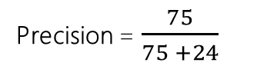
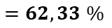
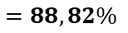
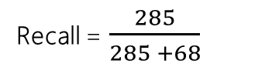
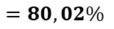
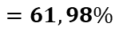
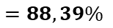
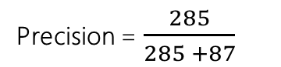
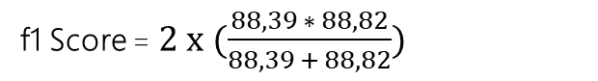
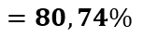
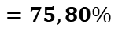
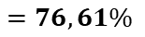
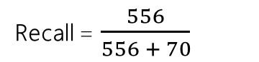
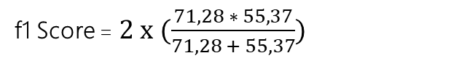
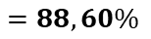
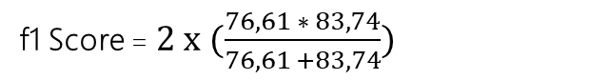
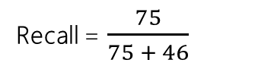
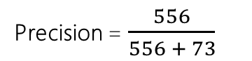
LONG SHORT TERM MEMORY (LSTM)
MODELING
Model evaluation using Confusion Matrix
Predicted Labels
Predicted Labels
Predicted Labels
Label 0 | 0 | != 0
0 | 285 | 68
!= 0 | 87 | 660
Label 1 | 1 | != 1
1 | 75 | 46
!= 1 | 24 | 955
Label 2 | 2 | != 2
2 | 556 | 70
!= 2 | 73 | 401
True Labels
True Labels
True Labels
Precision = $\frac{285}{285 +87}$
Precision = $\frac{75}{75 +24}$
Precision = $\frac{556}{556 + 73}$
$$=76,61\%$$
$$=75,80\%$$
$$=88,39\%$$
Recall = $\frac{285}{285 +68}$
Recall = $\frac{75}{75 + 46}$
Recall = $\frac{556}{556 + 70}$
$$=80,74\%$$
$$=61,98\%$$
$$=88,82\%$$
f1 Score = $2 x (\frac{76,61 ∗ 83,74}{76,61 +83,74})$
f1 Score = $2 x (\frac{71,28 ∗ 55,37}{71,28 + 55,37})$
f1 Score = $2 x (\frac{88,39 ∗ 88,82}{88,39 + 88,82})$
$$=80,02\%$$
$$=62,33 \%$$
$$=88,60\%$$

Slide 26
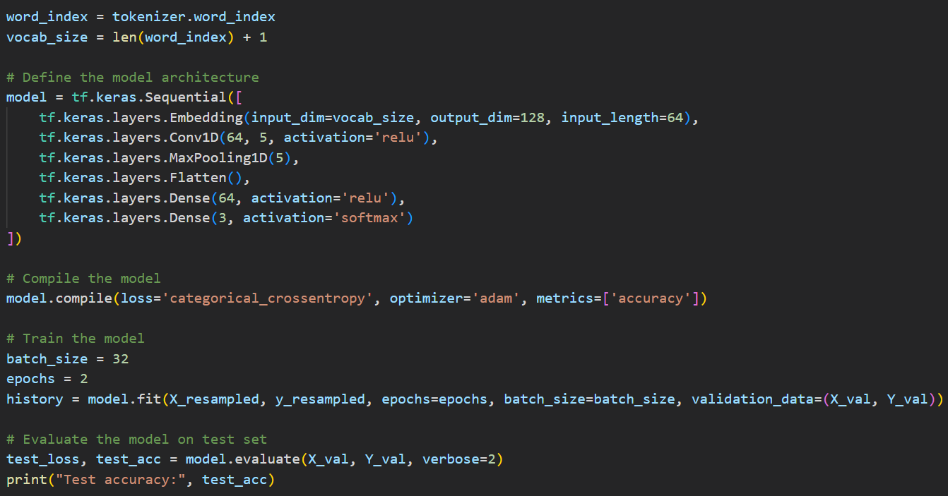
CONVOLUTIONAL NEURAL NETWORK (CNN)
MODELING
BUILD CNN MODEL AND TRAIN THE MODEL

Slide 27


CONVOLUTIONAL NEURAL NETWORK (CNN)
MODELING
Model evaluation using validation data

Slide 28


CONVOLUTIONAL NEURAL NETWORK (CNN)
MODELING
Model evaluation using test data

Slide 29

CONVOLUTIONAL NEURAL NETWORK (CNN)
MODELING
Model evaluation using Confusion Matrix
Precision = $\frac{TP}{TP + FP}$
Recall = $\frac{TP}{TP +FN}$
f1 Score = $2 x (\frac{Precision ∗Recall}{Precision+Recall})$

Slide 30





















Convolutional Neural Network (CNN)
MODELING
Model evaluation using Confusion Matrix
Predicted Labels
Predicted Labels
Predicted Labels
True Labels
True Labels
True Labels
Precision = $\frac{267}{267 +66}$
Precision = $\frac{66}{66 +12}$
Precision = $\frac{582}{582 +107}$
$$=80,18\%$$
$$=84,61\%$$
$$=84,47\%$$
Recall = $\frac{285}{285 +86}$
Recall = $\frac{75}{75 +55}$
Recall = $\frac{556}{556 +44}$
$$=76,81\%$$
$$=57,69\%$$
$$=92,66\%$$
f1 Score = $2 x (\frac{80,18 ∗76,81}{80,18 +76,81})$
f1 Score = $2 x (\frac{84,61 ∗57,69}{84,61+57,69})$
f1 Score = $2 x (\frac{84,47 ∗92,66}{84,47+92,66})$
$$=78,58\%$$
$$=68,60\%$$
$$=88,37\%$$

Slide 31

Feed Forward Neural Network (FFNN)
MODELING
BUILD FFNN MODEL AND TRAIN THE MODEL

Slide 32


Feed Forward Neural Network (FFNN)
MODELING
Model evaluation using validation data

Slide 33


Feed Forward Neural Network (FFNN)
MODELING
Model evaluation using test data

Slide 34

Feed Forward Neural Network (FFNN)
MODELING
Model evaluation using Confusion Matrix
Precision = $\frac{TP}{TP + FP}$
Recall = $\frac{TP}{TP +FN}$
f1 Score = $2 x (\frac{Precision ∗Recall}{Precision+Recall})$

Slide 35


















Feed Forward Neural Network (FFNN)
MODELING
Model evaluation using Confusion Matrix
Predicted Labels
Predicted Labels
Predicted Labels
Label 0 | 0 | != 0
0 | 272 | 81
!= 0 | 90 | 657
Label 1 | 1 | != 1
1 | 65 | 56
!= 1 | 17 | 962
Label 2 | 2 | != 2
2 | 572 | 54
!= 2 | 84 | 390
True Labels
True Labels
True Labels
Precision = $\frac{272}{272 +90}$
Precision = $\frac{67}{67 +17}$
Precision = $\frac{572}{572 +84}$
$$=75,13\%$$
$$=79,76\%$$
$$=87,65\%$$
Recall = $\frac{272}{272 +81}$
Recall = $\frac{67}{67 + 56}$
Recall = $\frac{552}{552 +54}$
$$=77,05\%$$
$$=54,47\%$$
$$=91,08\%$$
f1 Score = $2 x (\frac{75,13 ∗77,05}{75,13 +77,05})$
f1 Score = $2 x (\frac{79,76 ∗ 54,47}{79,76+ 54,47})$
f1 Score = $2 x (\frac{87,65∗91,08}{87,65+91,08})$
$$=76,07\%$$
$$=64,73 \%$$
$$=89,33\%$$

Slide 36
Which Evaluation Metrics We Use for Comparing Model?
MODELING
f1-score
WHY?!
f1-score | recall | precision | accuracy
Good for classification tasks (goals: all labels predicted) | Good for predict True Positive (in case: detect disease (covid-19) | Good for classification tasks (in case for: reducing false positive – people don’t have disease, but predicted have disease) | Good for classification tasks (in case : data have balance class)
Good for data with imbalance class | Good for data with imbalance class (in case: not bad loan and don’t have disease is minority class) | Good for data with imbalance class (in case: have bad loan and disease is minority class)
Combination of precision and recall (can reduce False Positive and False Negative)

Slide 37
COMPARING MODEL
MODELING
Based on Validation Data
 | f1-score | Weighted avg (f1-score) | Core Function | Training Speed | Model Complexity
Convolutional Neural Network (CNN) | Label 0: 80% Label 1: 73% Label 2: 91% | 85% | Image Classification | Faster than LSTM | *uses a one-dimensional convolution layer and a relatively simpler flatten layer *CNN can be used to handle text or image data well, due to its ability to learn more complex and intricate features in the data. *Conv1D and MaxPooling1D, CNN can maintain relationships between words in a sentence.
Long Short Term Memory (LSTM) | Label 0: 83% Label 1: 76% Label 2: 91% | 87% | Text Classification | Slower than CNN | *has more parameters because it uses LSTM layers and more complex layers such as dropout and regularization *LSTM has an advantage in recognizing more complex patterns and is better able to handle problems with longer texts.
Feed Forward Neural Network (FFNN) | Label 0: 77% Label 1: 67% Label 2: 89% | 83% |  | Same with CNN | The FFNN only consists of the Embedding, Flatten, and Dense layers which are relatively simpler compared to the other two models.
*In terms of complexity, the three models have different architectures and use different layers

Slide 38
CONCLUSION FOR MODELING
MODELING
Based on Validation Data
We decide to choose LSTM!
 | f1-score | Weighted avg (f1-score) | Core Function | Training Speed | Model Complexity
Long Short Term Memory (LSTM) | Label 0: 83% Label 1: 76% Label 2: 91% | 87% | Text Classification | Slower than CNN | *has more parameters because it uses LSTM layers and more complex layers such as dropout and regularization *LSTM has an advantage in recognizing more complex patterns and is better able to handle problems with longer texts.

Slide 39


API AND DOCUMENTATION
HTML
Swagger UI

Slide 40
Thank You

